Slide 1
The Challenge of Climate Change - “Managing our Greenhouse”
Michael Zammit Cutajar
(Executive Secretary, UNFCCC, 1991-2002,
Ambassador on climate change, Malta, 2002-2011)
Talk at Din L-Art Ħelwa, 14 May 2015
Slide notes expanded after delivery

Slide 2
Human impact on climate
Gases in atmosphere create natural “greenhouse effect”
condition for life on Earth; it would be too cold without it
Human activity since “Industrial Revolution” has been adding greenhouse gases (next slide)
mainly CO2 from economic growth generated by coal, then oil – and from forest clearing
This is destabilising the Earth’s climate

Slide 3
Notes:
Old graph – but shape is good
IPCC 2013: CO2 concentrations highest for 850,000 years, +40% since pre-industrial

Slide 4
“Climate change”
(NB. More accurate term than “global warming”; temperature change is not uniform across globe)
Not technical “pollution” issue, like e.g. clean air – we cannot do without the greenhouse, we must manage it
Issue = more and more people, producing and consuming more and more goods and services
Response = organise economies, cities, societies sustainably
= Profoundly political issue

Slide 5
Key messages – science (IPCC 5th assessment – 2013-14)
Global warming is unequivocal - approx. +1°C
global average surface temperature
So is human influence on warming
Impacts generally negative …
Extreme weather (floods, heat waves)
Sea-level rise: from thermal expansion + melting ice-caps and glaciers
Water stress, droughts
Ocean acidification
Spread of disease vectors, species extinction
WATCH 4-min science round-up: http://vimeo.com/75038049
(NB final 30 secs)
Notes:
NB. “Generally” – food +/- up to 1°C. Definitely negative beyond.

Slide 6
Key messages – politics
Impacts are negative and inequitable
hitting hardest where most poor people live
driving “climatic refugees”
Climate change = a signature issue of 21st C
Not the only issue – but aggravates familiar ones
poverty, hunger, disease, conflicts …
called “threat multiplier” by US Defense Dept.
Notes:
Pentagon report: CC = “threat multiplier”

Slide 7
Long-term political goal
Objective generally agreed in UN negotiations:
limit global warming to <2°C
i.e. 1°C above where we are now
This goal is not set by science
It is a political judgment of what could be manageable
NB. Vulnerable countries (e.g. low-lying island States) would feel safer with <1.5°C goal

Slide 8
Key message – energy futures
For 50/66% chance of staying within <2°C warming limit, IPCC estimates:
Total “carbon budget” +/- 800 Gigatons of Carbon (GtC)
“Spent” by end-2014 +/- 550 GtC
Balance 250 GtC = enough for 25 years at current emission rates of 10 GtC per year
Thus …
EITHER current coal/oil/gas business model for energy generation is replaced by mid-century
OR we keep going on track towards +4°C – DANGER
Notes:
NB. Carbon budget, not CO2

Slide 9
UNFCCC – negotiating phases
1988: Genesis
UNEP/WMO set up Intergovernmental Panel on Climate Change (IPCC)
Malta put “protecting the global climate” on UN General Assembly agenda
Foreign Minister Ċensu Tabone, advised by Dr. (now Prof.) David Attard
1991-1992: Convention (adopted 1992, in force 1994, now 195 States Parties - universal)
Sets out objective and principles; provides for cooperation and information exchange
Sets mitigation aim for developed countries: return to 1990 emission levels by 2000 (achieved collectively on account of post-Soviet economic implosion)
1995-2001: Kyoto Protocol (adopted 1997, in force 2005)
Mitigation targets for developed countries: aggregate emissions 5% below 1990 in 2008-2012
First step “made in USA”, with flexibility mechanisms to lower costs of achieving targets
But “broken in USA”: Clinton never submitted to Senate, G.W. Bush dropped it
KP now in 2nd phase – with drop-outs (Canada, Japan, Russia) - marking time to 2020 …
2005-2015: Comprehensive agreement, effective 2020?
2009-2010: Copenhagen & Cancún conferences
Agreed aims: <2°C limit; mobilising $100bn/year climate finance by 2020
2011-2015: Durban Platform => towards Paris Agreement Dec. 2015??
Notes:
1990: Brazil/Mexico move to take negotiations out of UNEP/WMO and bring under UN
US Kyoto story: Byrd/Hagel, Gore …
CPH mess put into order in Cancun – but not enough

Slide 10
Why are negotiations so difficult? 1
Science is not prescriptive
Who does what, when? = political judgments
Short-term economic interests influential
leading to defensive economic judgments
e.g. about competitiveness, employment
Varying evaluations of risks & responses
According to situation, capacity to respond, perspective
e.g. melting Greenland = 7m sea-level rise over centuries
But ice-free Arctic = open for shipping routes and oil/gas exploration (see next slide)
Notes:
Compare response to health crises, e.g. link between ozone depletion and skin cancer
E.g. Indian Ocean SLR (Maldives – B’desh – India), E.g. Arctic melt

Slide 11
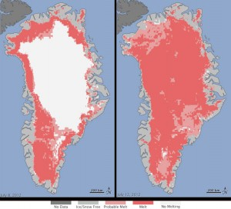
Arctic Sea Ice - minimum 2012
NSIDC, USA - data Sept. 2012
Greenland mid-July 2012
Arctic sea ice extent for Sept 2012 was 3.61 m km2. The magenta line shows 1979 to 2000 median extent for that month.
Notes:
3rd lowest since 1979. (Lowest was Sept 2007)
http://nsidc.org/news/press/20121002_MinimumPR.html

Slide 12
Why are negotiations so difficult? 2
Institutions
Consensus rule with 190+ countries - requires skillful chairing to bring numbers plus weight on-side (re weight, see slide 13)
US Senate generally wary of new treaties
Debates around Convention principles:
Equity + “Common but differentiated responsibilities and respective capabilities” – pitting historical responsibilities vs evolving capabilities (see slides 14-16)
Developed countries “should take the lead” – others should follow …
Now conditioned by “different national circumstances” – evolution?
Geopolitical rivalries
Emerging South v Old North, China-USA, NB. Russian position

Slide 13
Critical mass - top 25 « footprints » (WRI/CAIT: Data for 2011)
Top 25 in
Population
Poland
Spain
Top 25 in GDP
Egypt Pakistan Thailand
Bangladesh
Philippines
Myanmar
Ethiopia
D.R. Congo Vietnam
China, USA, [EU28,] Brazil, Indonesia, Russia, India, Japan, Germany, Mexico, UK, Italy, France, Iran, Turkey, Nigeria
Saudi Arabia,
Rep. Korea
Australia Canada
Malaysia, South Africa, Argentina,
Venezuela,
Ukraine
Top 25 in
GHG emissions
(incl. land-use & forestry)
Green = OPEC
Red = Other fossil fuel exporters
Notes:
Comprehensiveness: demographic, economic and ecological footprints – overlying differentiated responsibilities and capacities to respond, in particular per capita measures.
Countries in each circle represent 80% of global total (GDP 90%)??
Total 29 countries + EU28. Central overlap must be core of meaningful dea. Note fossil exporters. [POP 64%, GHG 73%, GDP 79% ??]

Slide 14
Historical responsibility (% cumulative emissions)
1880 1940 2000
Notes:
CO2 atmospheric life-time 100 years?

Slide 15
Current emissions (2011) (six gases, incl. from land-use change and forestry; source WRI/CAIT)
Countries/Regions | % of world emissions |  | Tons per capita (CO2/equivalent)
 |  |  |  | Equity indicator
USA |  | 13% |  | 20
EU (28) |  | 9% |  | 8
NORTH |  | 36% |  | 13
WORLD |  | - |  | 7
SOUTH |  | 64% |  | 5
China |  | 23% |  | 8
India |  | 5% |  | 2
Notes:
Emissions per cap = “fairness”.
China = EU; USA = 2+ x EU, Japan, China; USA = 10 x India; China = 4x India

Slide 16
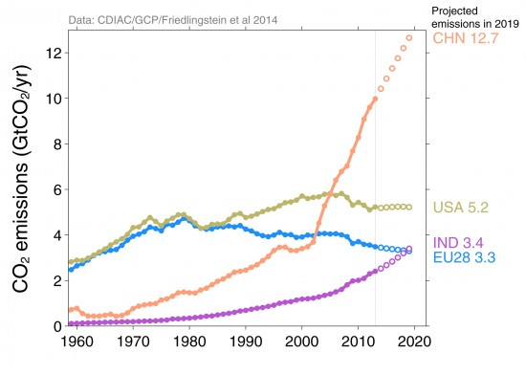
Projected emissions growth
Notes:
Note China’s explosion since 1992 Convention and its annexes

Slide 17
Geo-politics: China – USA
“G.2 super-emitters”:
Comparable recent atmospheric impacts, but NB ..
USA historical weight, China future projections
Different national circumstances, e.g.
GDP (PPP) per capita: China $12K, USA $53K
Similar sovereign outlook and interests
Both prefer “bottom-up” pledges to “top-down” commitments
Nov. 2014 joint announcement of intent (Ji/Obama)

Slide 18
Positive economic messages
Stern 2006: Prevention cheaper than cure
if one values future generations
Calderón 2014: Better growth now = better climate – “New Climate Economy” report
“Green Economy” => low/no-cost options
Cities, energy, transport, land use/forests,
COP 21 “Action Agenda”
Initiatives by regions, cities, corporations, civil society
Notes:
Calderon 2014 = “The New Climate Economy” report of the Global Commission on the Economy and ClImate

Slide 19
UNFCCC negotiations => Paris COP 21: Possible “big picture”
All aboard: bottom-up nationally-determined “contributions”
Pledges likely better than “business as usual” – but not enough to signal we are on track to <2°C limit
Commitments - by all? – to:
transparency, accountability
negotiating rounds of progressive future contributions
Towards long-term mitigation goal
<2°C/1.5% limit, “carbon neutrality”, “climate safety”
X% reduction by 2050 => pathway to zero net emissions
Financial mobilisation =>$100bn, esp. for adaptation to +2°C
Political issues: Legal character? Differentiation North-South?
Notes:
MZC personal view

Slide 20
Food for thought
Fossil fuels beyond mid-century
What share of reserves must stay in the ground?
Can new technologies extend their sustainable value?
Climate change and poverty
Poor people must have access to energy
War on two fronts
Democratic dilemma
Future generations have no vote
How can democracy generate consensus and action towards interests of the future?
Notes:
“Poverty is worst form of pollution” – Indira Gandhi, Stockholm 1972

Slide 21
Signals to Malta
Water policy
Prospect of water stress (next slide)
Need for political focus on water conservation, recycling … and against pollution, theft
Electricity sourcing
Gas is more climate-friendly than oil – but still a fossil fuel
Instead of pipeline for gas from Russia/Caucasus, should we be considering solar power from Sahara over new interconnector?
Green Growth
Intelligent urban & transport planning, retro-fitting for energy-efficient buildings
Geo-politics
What is Malta’s place in a Pacific world order? (slides 23-24)

Slide 22
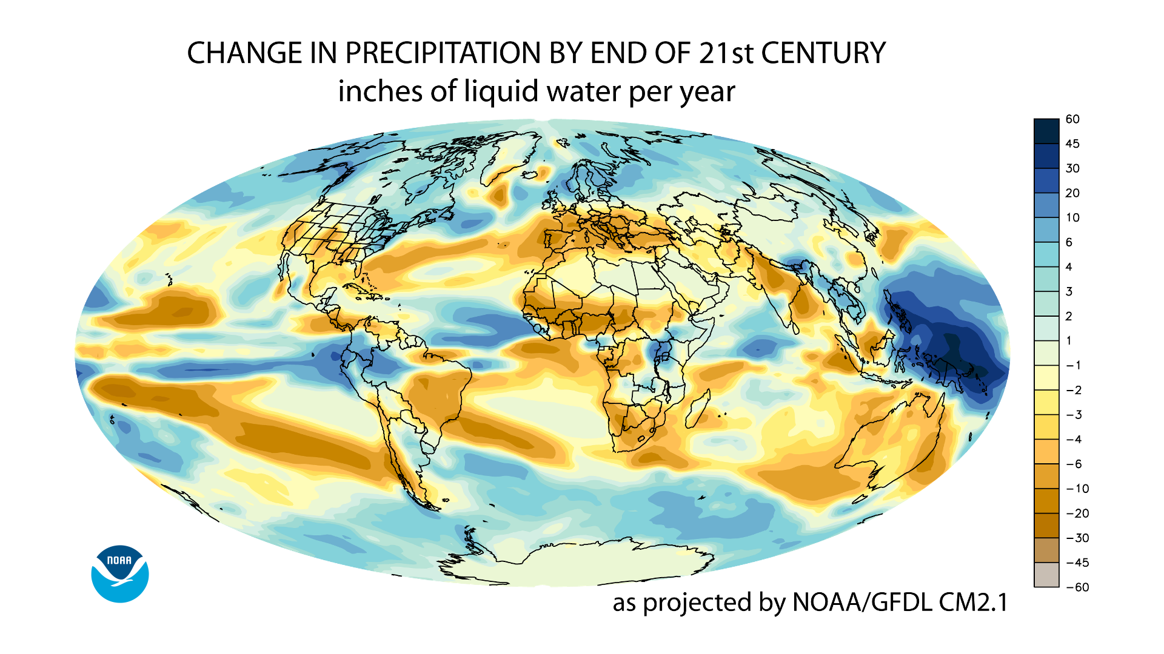

Slide 23
Old World?

Slide 24
New World?

Slide 25
For more information:
www.ipcc.ch
www.unfccc.int
cait2.wri.org
http://vimeo.com/75038049 www.newclimateeconomy.report

